Slide 1
Welcome back to CIS 530!
Please type your questions in the chat
if your internet is too slow to see the video, You can find the slides on the class website

Slide 2
New course policies
I’m granting everyone 10 extra late days. You can now use up to 3 late days per HW, quiz or project milestone.
I’m offering a HW option for the term project component of the grade. You can do 4 extra HW assignments instead of a project.
I’m allowing everyone to drop their lowest scoring quiz.
Everyone can drop their lowest scoring homework. (You can’t drop project milestones).
You can opt to do the course pass/fail. 50% and above is passing.

Slide 3
Homework Option
We are creating a set of 4 additional weekly homework assignments. They will have the same deadlines as the project milestones. You may do the homework assignments individually or in pairs.
HW9: Classifying Depression due – requires special data access
HW10: Neural Machine Translation
HW11: BERT
HW12: Perspectives Detection
You can do the homework individually or in pairs.
HW will be graded based on leaderboard and reports (autograders may not be available).
Notes:
Because the homework assignments are new, some of them might not have autograders. They will instead be graded based on the leaderboard and on your report.

Slide 4
Project Option
The project is a team exercise, with teams of 4-6. Your project will be a self-designed multi-week team-based effort. Milestones:
Submit a formal project definition and a literature review. (due 4/8)
Collect your data, write an evaluation script and a baseline. (4/15)
Implement a published baseline. Prepare a draft of your final project presentation. (4/22)
Finish all your extensions to the public baseline, and submit your final report. (4/29)
You need to declare whether you intend to do the project or homework option by this Wednesday using the Google form linked on Piazza.
http://computational-linguistics-class.org/term-project.html
Notes:
You may reach out to the instructor on gradescope for special circumstances about team size.
If you don’t have an idea about what you’d like to do for the project, or if you’re having trouble coordinating a team, we recommend the homework option.

Slide 5
Office hours
Office hours are going to be held via Zoom. TAs host a host a Zoom group meeting and post the link on Piazza.
We will use the chat to manage the queue. Just like you would write your name on the whiteboard in an in-person meeting. You should write this info to add yourself to the queue:
Your name
A short version of your question
Whether it should be discussed publicly and privately (code help)
For private questions, the TA will add you to a breakout room. For public ones, we’ll discuss them as a group so you can hear the answers to other students’ questions.
Notes:
Please give us feedback at the end of the week whether this is working or ideas on how we can improve this process.

Slide 6

Schedule
http://computational-linguistics-class.org/lectures.html#now
Notes:
Zoom links to live lecture

Slide 7
Reminders
Homework 7 due Date is Due by Midnight on 3/25. HW8 will be due 4/1.
Wash your hands
Take care of yourself. Mental health is important too.

Slide 8
Review: Constituency Parsing
Jurafsky and Martin Chapters 12-14

Slide 9
Formal Definition of a PCFG
A probabilistic context-free grammar G is defined by four parameters:
N is a set of non-terminal symbols (or variables)
In NLP, we often use the Penn Treebank tag set
Σ is set of terminal symbols
These are the words (also sometimes called the leaf nodes of the parse tree)
R is a set of production rules, each of the form A → β [probability]
S → NP VP [0.8]
S → Aux NP VP [0.15]
S → VP [0.05]
S is the start symbol (a non-terminal)
Notes:
CFGs are something that we study in both linguistics and computer science. In computer science we study them in courses on Automata Theory, Languages, and Computation.

Slide 10
Treebanks as grammar
Treebanks == data
Initially, building a treebank might seem like it would be a lot slower and less useful than building a grammar.
However, a treebank gives us many things
Reusability of the labor
Many parsers, POS taggers, etc.
Valuable resource for linguistics
Broad coverage
Frequencies and distributional information
A way to evaluate systems
Mitch Marcus
[Marcus et al. 1993, Computational Linguistics]

Slide 11
Extracted rules
S → NP VP . | DT → That | JJ → full
NP → DT JJ , JJ NN | JJ → cold | IN → of
VP → VBD ADJP | , → , | NN → fire
ADJP → JJ PP | JJ → empty | CC → and
PP → IN NP | NN → sky | NN → light
NP → NN CC NN | VBD → was
Notes:
For simplicity, let’s strip off the rule suffixes (-SBJ and so on).

Slide 12
Rules with counts
40717 PP → IN NP
33803 S → NP-SBJ VP
22513 NP-SBJ → -NONE-
21877 NP → NP PP
20740 NP → DT NN
14153 S → NP-SBJ VP .
12922 VP → TO VP
11881 PP-LOC → IN NP
11467 NP-SBJ → PRP
11378 NP → -NONE-
11291 NP → NN
...
989 VP → VBG S
985 NP-SBJ → NN
983 PP-MNR → IN NP
983 NP-SBJ → DT
969 VP → VBN VP
100 VP → VBD PP-PRD
100 PRN → : NP :
100 NP → DT JJS
100 NP-CLR → NN
99 NP-SBJ-1 → DT NNP
98 VP → VBN NP PP-DIR
98 VP → VBD PP-TMP
98 PP-TMP → VBG NP
97 VP → VBD ADVP-TMP VP
...
10 WHNP-1 → WRB JJ
10 VP → VP CC VP PP-TMP
10 VP → VP CC VP ADVP-MNR
10 VP → VBZ S , SBAR-ADV
10 VP → VBZ S ADVP-TMP
Compute Probabilities using MLE.
Notes:
Any guesses on how many unique VP rules there are?

Slide 13
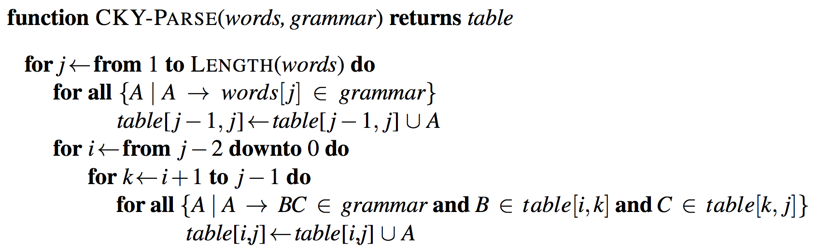
CKY Algorithm
CKY Demo at http://lxmls.it.pt/2015/cky.html
Notes:
O(N^3 * |R|)
n: Number of tokens in the sentence
|R|: Number of rules
The outermost loop of the algorithm iterates over the columns, and the second loop iterates over the rows, from the bottom up.
The purpose of the innermost loop is to range over all the places where a substring spanning i to j in the input might be split in two.
As k ranges over the places where the string can be split, the pairs of cells we consider move, in lockstep, to the right along row i and down along column j.

Slide 14
Ambiguity
Ambiguity can arise because of words with multiple senses or POS tags. Many kinds of ambiguity are also structural.

Slide 15
Attachment Ambiguity
Probabilities give us a way of choosing between possible parses.
Notes:
Another example: We saw the Eiffel Tower flying to Paris.

Slide 16
Finding best parse
Pick the parse with the highest probability.
=
P(T,S) = 2.2 * 10⁻⁶
P(T,S) = 6.1 * 10⁻⁷

Slide 17
Constituents have heads
Notes:
Chapter 12 introduced a head-finding algorithm by Michael Collins, who did his PhD at Upenn and is now a Prof. at Columbia + researcher at Google.

Slide 18
Dependency Parsing
Jurafsky and Martin Chapter 15

Slide 19
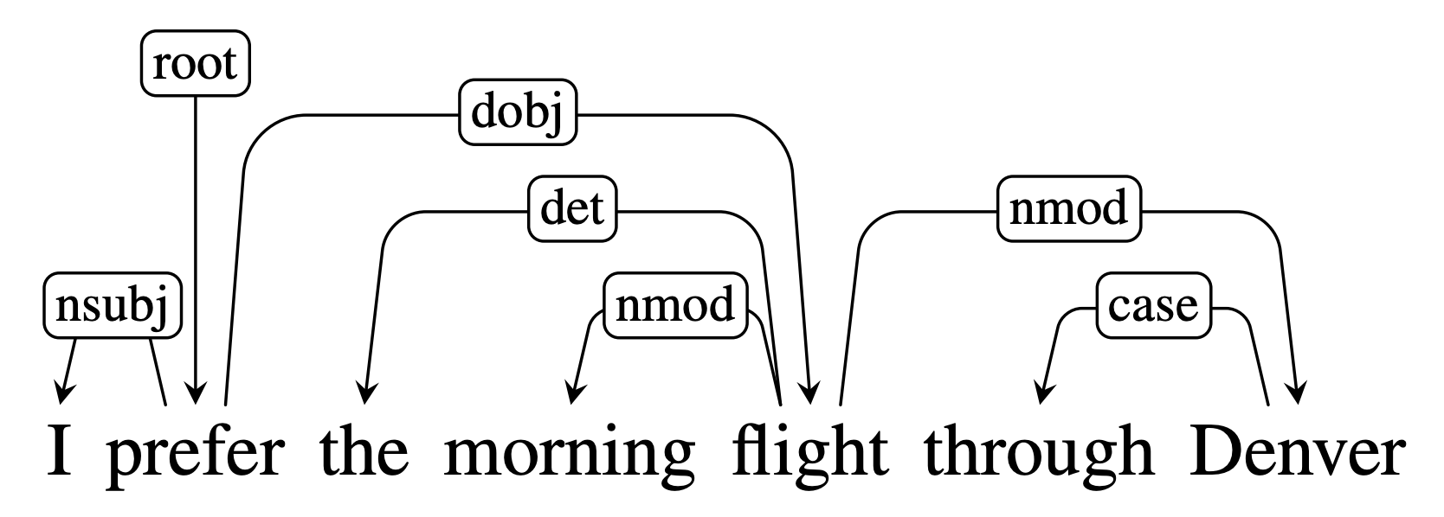
Dependency Grammars
Dependency grammars depict the syntactic structure of sentences solely in terms of the words in a sentence and an associated set of directed head-dependent grammatical relations that hold among these words.

Slide 20
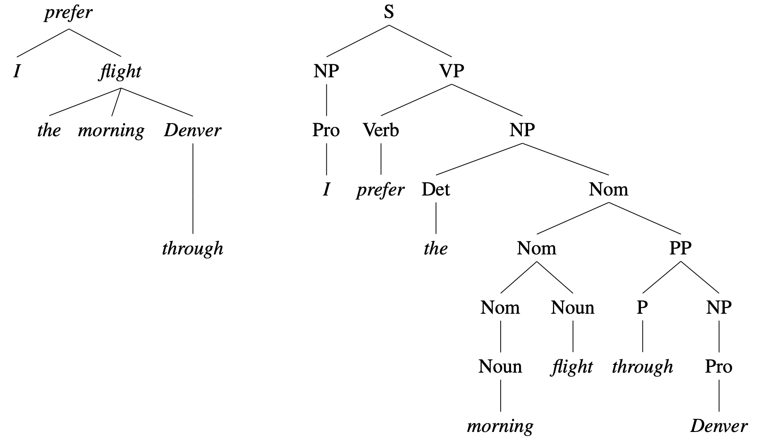
Dependency – based
Constituent– based
Notes:
Unlabeled

Slide 21
Advantages of dependencies
Dependencies don’t have nodes corresponding to phrasal constituents. Instead they directly encode information that is often buried in phrase structure parses.
Dependency grammars are better able deal with languages that have a relatively free word order.
Dependency relations approximate semantic relationships between words and arguments, which is useful for many applications
coreference resolution
question answering
information extraction.
Notes:
Dependency grammars abstract away from word-order information, representing only the information necessary for the parse. In contrast, phrase-structure grammars need separate rules for each possible place in the tree where a phrase can occur.
semantic relationship between the words and their arguments, which is directly useful for many applications, such as: coreference resolution, question answering and information extraction.

Slide 22
Dependency Formalism
The dependency structures are directed graphs.
G = (V, A)
where V is a set of vertices and A is a set of ordered pairs of vertices (or directed arcs). Each arc points from the head to a dependent
Directed arcs can also be labeled with the grammatical relation that holds between the head and a dependent.
Head
Dependent
Notes:
Familiar notions such as subject, direct object and indirect object are examples of grammatical relations. In English these notions strongly correlate with both position in a sentence and constituent type and are therefore somewhat
redundant with the kind of information found in phrase-structure trees. However, in
more flexible languages the information encoded directly in these grammatical rela-
Universal Dependencies
tions is critical since phrase-based constituent syntax provides little

Slide 23
Dependency Trees
Other common constraints are that dependency structure must be connected, have a designated root node, and be acyclic or planar. These result in a rooted tree called a dependency tree.
A dependency tree is a digraph where:
There is a single designated root node that has no incoming arcs
Each vertex has exactly one incoming arc (except the root node)
There is a unique path from the root node to each vertex in V
This mean that each word in the sentence has exactly one head.
Head
Dependent

Slide 24
Dependency Trees
A dependency structure can be represented in the forms of a directed graph G = (V, A) where V refers to the set of words in each sentence, and A refers to the set of arcs capturing grammatical relationships. A dependency tree also satisfies the following constraints:
There is a single designated root node that has no incoming arcs
Each vertex has exactly one incoming arc (except the root node)
There is a unique path from the root node to each vertex in V
Together, these constrains ensure that the dependency structure is connected and that there is a single root node connected to the remaining vertices by unique paths.

Slide 25
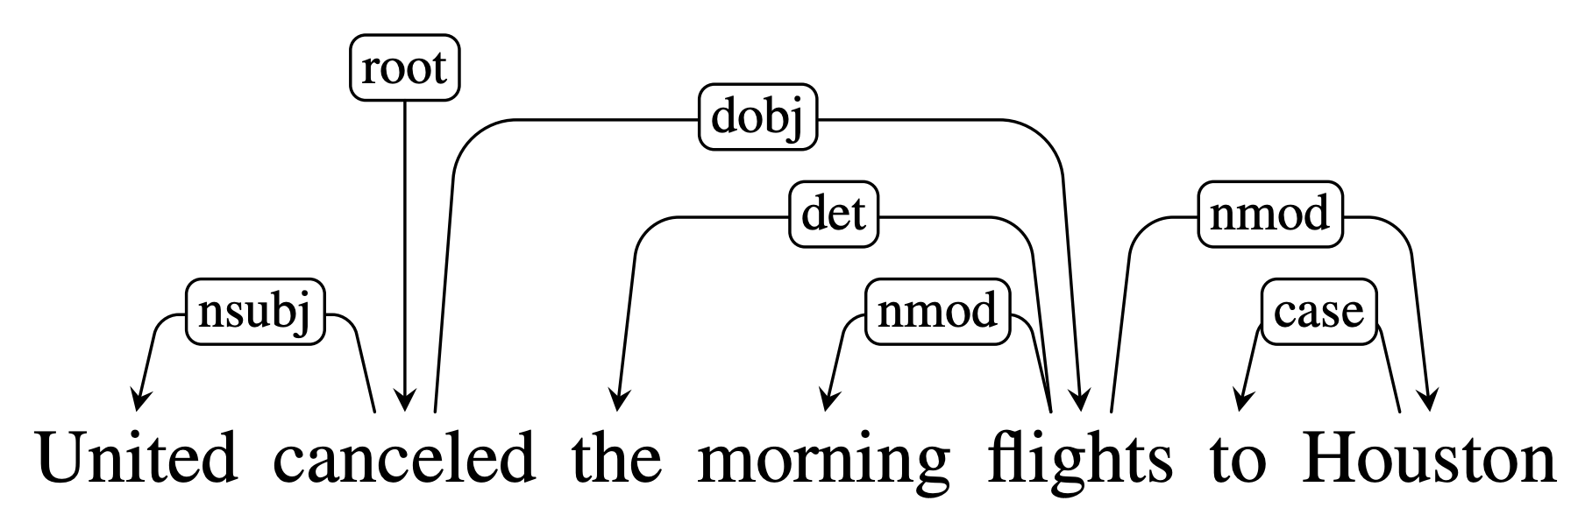
Dependency Relations
In addition having directed arcs point from the head to the dependent, arc can be labeled with the type of grammatical function involved between the words
nsubj and dobj identify the subject and direct object of the verb cancelled
nmod, det and case relations denote modifiers of the nouns flights and Houston.
Notes:
Familiar notions such as subject, direct object and indirect object are examples of grammatical relations. In English these notions strongly correlate with both position in a sentence and constituent type and are therefore somewhat
redundant with the kind of information found in phrase-structure trees. However, in
more flexible languages the information encoded directly in these grammatical rela-
Universal Dependencies
tions is critical since phrase-based constituent syntax provides little

Slide 26
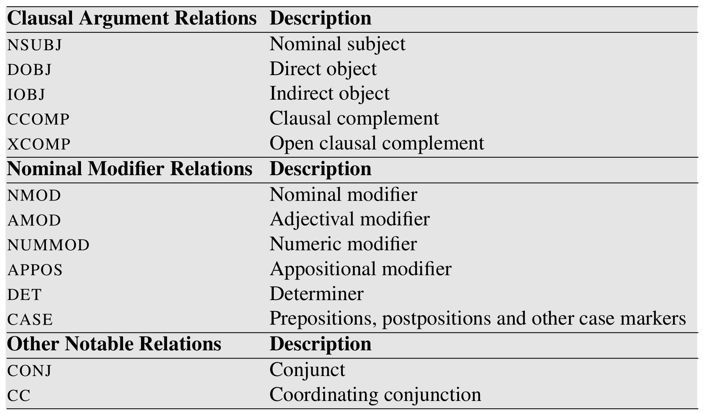
Dependency Relations
Notes:
Selected dependencies from the Universal Dependency Set.

Slide 27
Dependency Relations
Relation | Examples with head and dependent
NSUBJ | United canceled the flight.
DOBJ | United diverted the flight to Reno.
IOBJ | We booked her the flight to Miami.
NMOD | We took the morning flight.
AMOD | Book the cheapest flight.
NUMMOD | JetBlue canceled 1000 flights.
APPOS | United, a unit of UAL, matched the fares.
DET | The flight was canceled.
CONJ | We flew to Denver and drove to Steamboat.
CC | We flew to Denver and drove to Steamboat.
CASE | Book the flight through Houston.
Notes:
The Universal Dependencies project provides an inventory of dependency relations that are linguistically motivated and computationally useful.

Slide 28
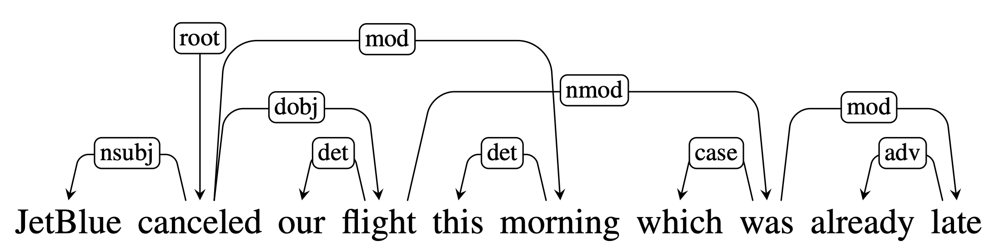
Projectivity
An arc from a head to a dependent is said to be projective if there is a path from the head to every word that lies between the head and the dependent in the sentence.
A dependency tree is said to be projective if it can be drawn with no crossing edges.
An example of a non-projective dependency tree.

Slide 29
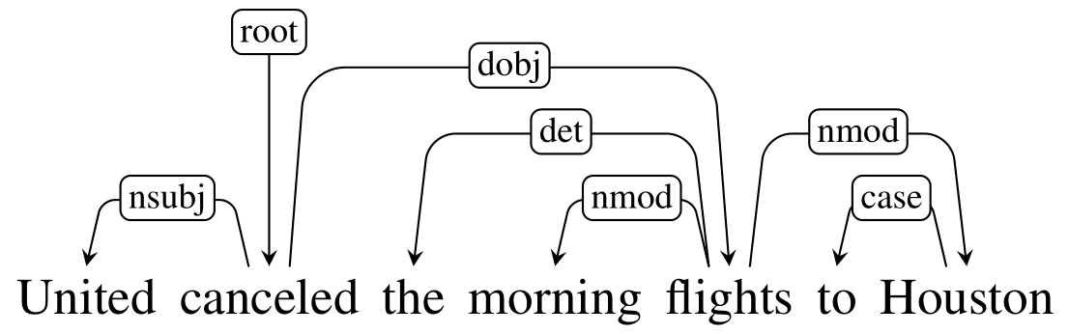
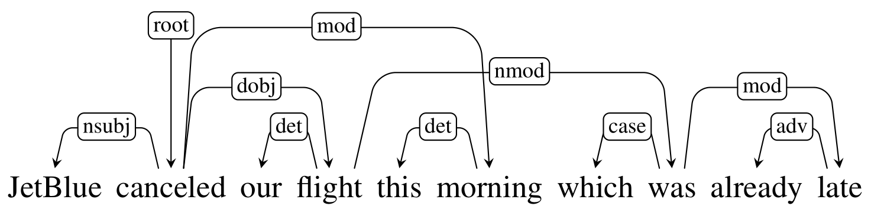
Projective vs Non-projective

Slide 30
Dependency Treebanks
Dependency Treebanks are typically created by the following methods:
Having human annotators build dependency structures directly
Using an automatic parser and then employing human annotators to correct the output
Automatically transforming phrase-structure treebanks into dependency structure treebanks
Directly annotated dependency treebanks have been often created for morphologically rich languages such as Czech (Prague Dependency Treebank), Hindi and Finnish.

Slide 35
Parsing Methods
There are two main approaches used in dependency parsers:
Transition-Based
Graph-Based
Transition-based approaches can only produce projective trees. Therefore any sentences with non-projective structures will contain errors.
In contrast, graph-based parsing approaches can handle non-projectivity but are more computationally expensive.

Slide 36
Transition-based Parsing
Transition-based parsing systems employ a greedy stack-based algorithm to create dependency structures.
A key element in transition-based parsing is the notion of a configuration which consists of a stack, an input buffer of words and a set of relations representing the dependency tree.
Parsing consists of a sequence of “shift-reduce” transitions. Once all the words have been moved off the stack, they have each and been assigned a head (and an appropriate relation).
The resulting configuration is a dependency tree.

Slide 37
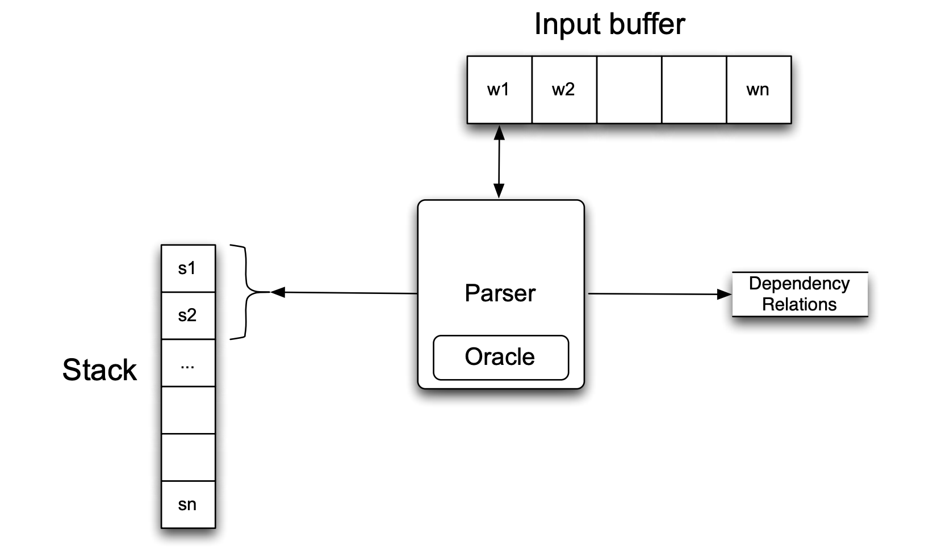
Transition-based Parser
The parser examines the top two elements of the stack and selects an action based on consulting an oracle that examines the current configuration.

Slide 38
Transition-based Parser
Intuition: create a dependency tree by examining the words in a single pass over the input, moving from left to right:
• Assign the current word as the head of some previously seen word,
• Assign some previously seen word as the head of the current word,
•Or postpone doing anything with the current word, adding it to the stack so that it can be processed later.

Slide 39
Transition-based Parser
Complexity is linear in the length of the sentence O(V) since it is based on a single left to right pass through the words in the sentence ➞ each word must be first shifted onto the stack and then reduced

Slide 40
Operators
There are three transition operators that will operate on the top two elements of the stack:
LEFTARC: Assert a head-dependent relation between the word at the top of the stack and the word directly beneath it; remove the lower word from the stack.
RIGHTARC: Assert a head-dependent relation between the second word on the stack and the word at the top; remove the word at the top of the stack;
SHIFT: Remove the word from the front of the input buffer and push it onto the stack.

Slide 41
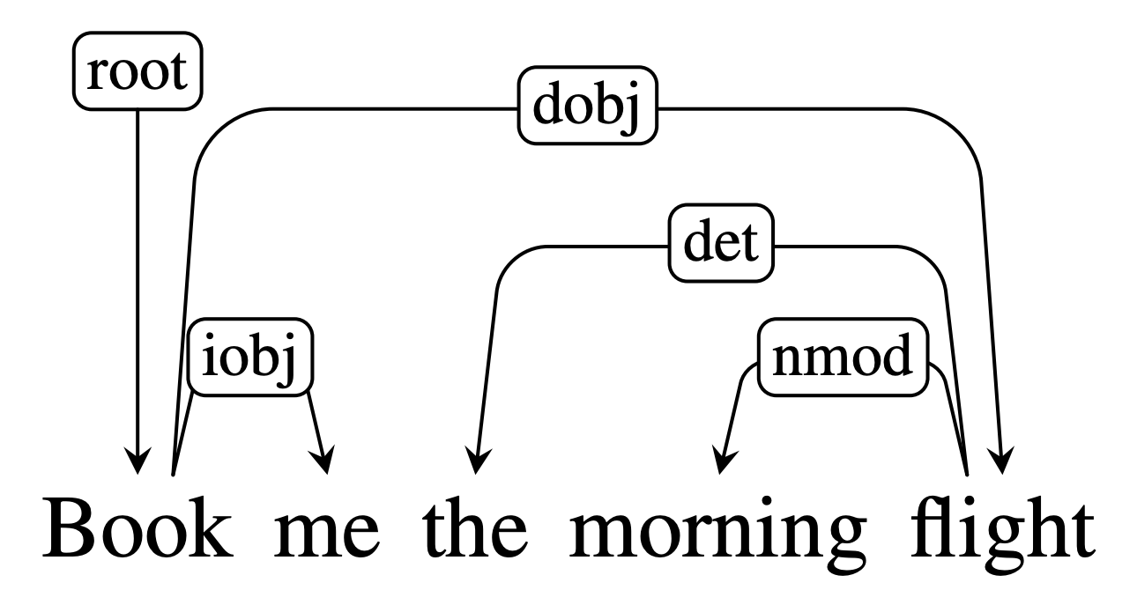
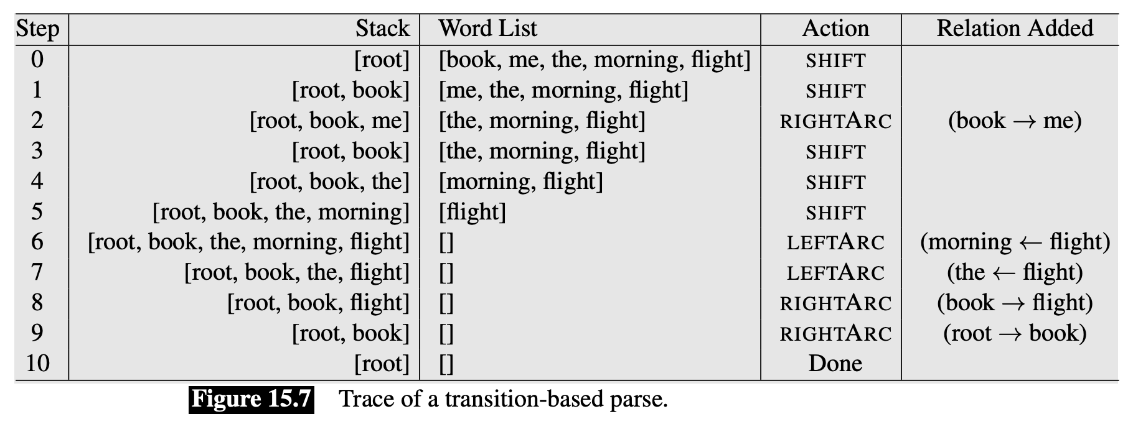
Worked example:

Slide 42
input buffer:
Book
me
a
morning
flight
stack:
Root
}
Parser
Action: Shift
Root
Book
me
a
morning
flight

Slide 43
input buffer:
me
a
morning
flight
Book
}
Parser
stack:
Root
Action: Shift
Root
Book
me
a
morning
flight

Slide 44
input buffer:
a
morning
flight
me
}
Parser
stack:
Book
Action: RightArc
Root
iobj
Root
Book
me
a
morning
flight

Slide 45
input buffer:
a
morning
flight
Book
}
Parser
stack:
Root
Action: Shift
iobj
Root
Book
me
a
morning
flight

Slide 46
input buffer:
morning
flight
a
}
Parser
stack:
Book
Action: Shift
Root
iobj
Root
Book
me
a
morning
flight

Slide 47
input buffer:
flight
morning
stack:
}
Parser
a
Action: Shift
Book
Root
iobj
Root
Book
me
a
morning
flight

Slide 48
input buffer:
flight
}
Parser
stack:
morning
Action: LeftArc
a
Book
Root
iobj
nmod
Root
Book
me
a
morning
flight

Slide 49
input buffer:
flight
}
Parser
stack:
a
Action: LeftArc
Book
Root
det
iobj
nmod
Root
Book
me
a
morning
flight

Slide 50
input buffer:
flight
}
Parser
stack:
Book
Action: RightArc
Root
dobj
det
iobj
nmod
Root
Book
me
a
morning
flight

Slide 51
input buffer:
stack:
Book
}
Parser
Root
Action: RightArc
dobj
det
root
iobj
nmod
Root
Book
me
a
morning
flight

Slide 52
input buffer:
Root
}
Parser
stack:
Action: Done
dobj
det
root
iobj
nmod
Root
Book
me
a
morning
flight

Slide 53
Creating the Oracle
SOTA transition-based systems use supervised machine learning methods to train classifiers that play the role of the oracle, which takes in as input a configuration and returns as output a transition operator.
Problem: What about the training data? To train the oracle, we need configurations paired with transition operators, which aren’t provided by the Treebanks…
Solution: simulate the operation of the parser by running the algorithm and relying on a new training oracle to give correct transition operators for each successive operation.

Slide 54
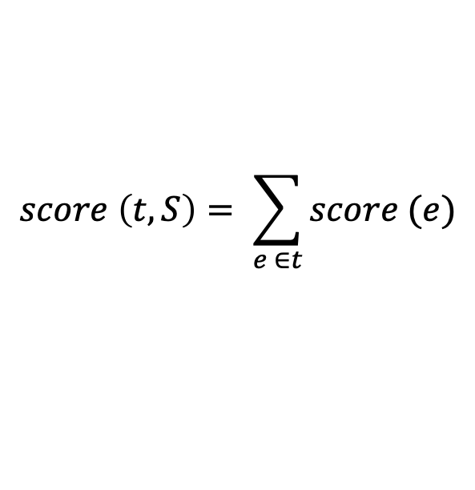
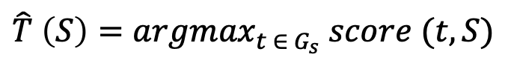
Graph-based Parsing
Graph-based methods for creating dependency structures search through the space of possible dependency trees for a tree that maximizes some score function:
where, the score for a tree is based on the scores of the edges that comprise the tree:
A common approach involves the use of maximum spanning trees (MST)
$$\hat{T} \left(S\right)={argmax}_{t ∈{ G}_{s}} score (t, S)$$
$$score \left(t, S\right)= \sum_{e ∈t}{score (e)}$$

Slide 55
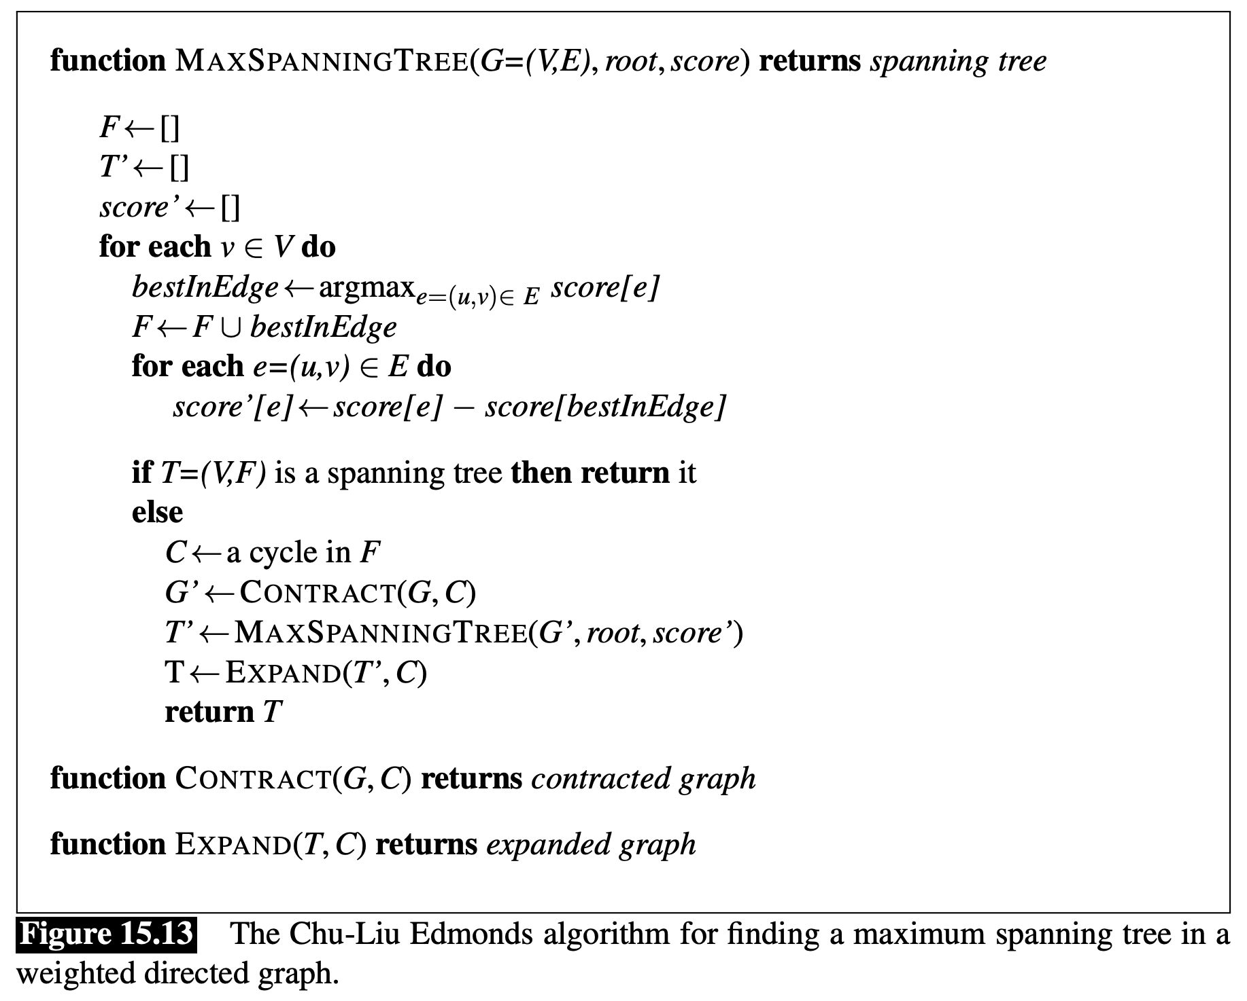

Slide 56
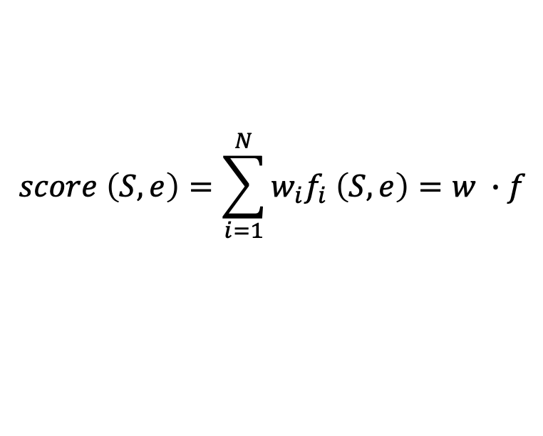
Training
While we can reduce the score of tree to a sum of the scores of the edges that comprise it, each edge score can also be reduced to a weighted sum of features extracted from it.
Commonly used features include:
$$score \left(S, e\right)=\sum_{i=1}^{N}{w_{i}f_{i} \left(S, e\right)}=w ∙f$$
Wordforms, lemmas and POS of the headword and dependent
Corresponding features of contexts before, after and between words
Word embeddings
Dependency relation type
Direction of the relation (to the right or to the left)
Distance from the head to the dependent

Slide 57
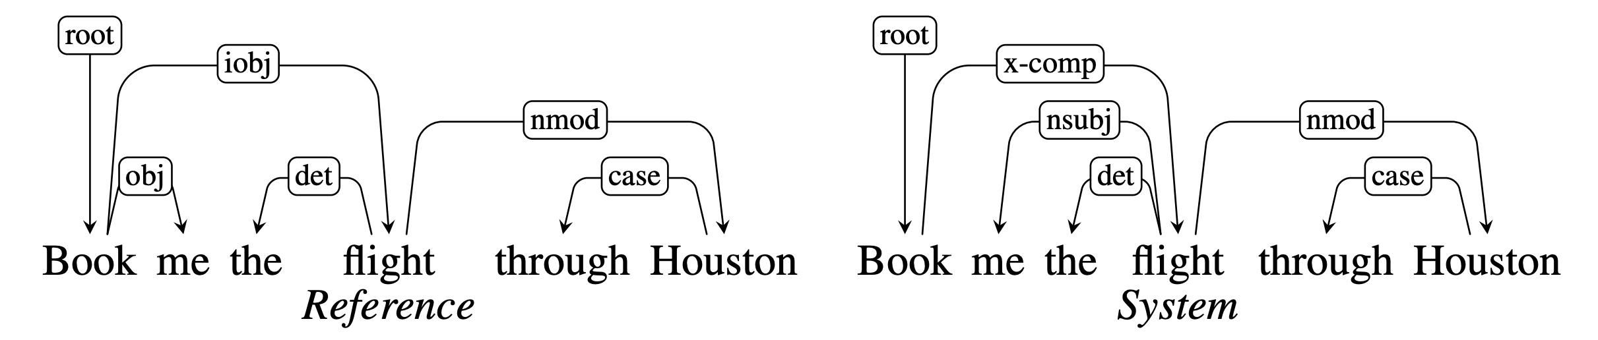
Evaluation
The common method for evaluating dependency parsers are labeled attachment accuracy (LAS) and unlabeled attachment accuracy
Labeled attachment refers to the proper assignment of a word to its head with the correct dependency relation.
Unlabeled attachment refers to the proper assignment of a word to its head ONLY (ignores dependency relation)
LAS = 2/3, UAS = 5/6

Slide 58

Next time: Logical Representations of Sentence Meaning

